Slide 1

Comprehensive Travel Planner App
Under the Guidance of
Mr. Kishor S
Assistant Professor
TEAM ID: CEC/CSE/2025-26/P-04
4CB22CS012 Aniruddh Nayak
4CB22CS005 Akash D Shenvi
4CB22CS009 Anantha 4CB22CS051 Joylan Dsouza

Slide 2
Table Of Contents
Introduction
Problem Definition
Literature Survey
Gaps Identified
Objectives
Methodology
Expected Outcome
Conclusion

Slide 3
Introduction
This project aims to develop a comprehensive travel planner application that streamlines the travel planning process.
The application features an integrated chatbot designed to provide real-time personalized recommendations.

Slide 4
Problem Definition
Travelers often struggle to plan trips, especially in unfamiliar places. Finding reliable information about attractions, dining, and activities is time-consuming and spread across many apps. Most travel recommendations are not personalized. This makes the planning process complicated and inefficient. As a result, travelers feel frustrated and less satisfied with their experiences.

Slide 5
Literature Survey
Title of the Paper | Author(s) | Methodology | Observation | Limitations
"Chatbot-Driven Travel Planning" | Jane Smith et al. | Used NLP to build a travel chatbot. | Improved travel suggestions and user satisfaction. | Limited to text-based interactions.
"Mobile Travel Apps: A Review" | John Doe and Emily Lee | Analyzed features of 10 travel apps. | Integrated booking improves user convenience. | Apps still require switching platforms.
"AI for Personalized Travel" | Maria Gonzalez et al. | Developed an ML model for travel recommendations. | Enhanced user satisfaction with tailored suggestions. | Needs extensive user data; privacy concerns.
"Real-Time Assistance in Tourism" | Rajesh Sharma and Li Wei | Designed a travel app prototype for live updates. | Real-time updates reduce traveler stress. | Relies on stable internet connectivity.
"All-in-One Travel Platforms" | Ahmed Khan et al. | Compared single-platform vs. multi-platform planning. | Users prefer consolidated travel solutions. | Integration with third-party services is hard.

Slide 6
Gaps Identified
Internet Dependency: The app depends a lot on having a stable internet connection. This can be a problem for users traveling in areas where the network is weak or unavailable.
Data Quality Issues: The chatbot's recommendations may not always be accurate or reliable because they depend on the quality and availability of the data it uses.

Slide 7
Objectives
Create a seamless travel planner for discovering local attractions, restaurants, and places.
Implement a chatbot for personalized travel assistance and tailored recommendations.

Slide 8
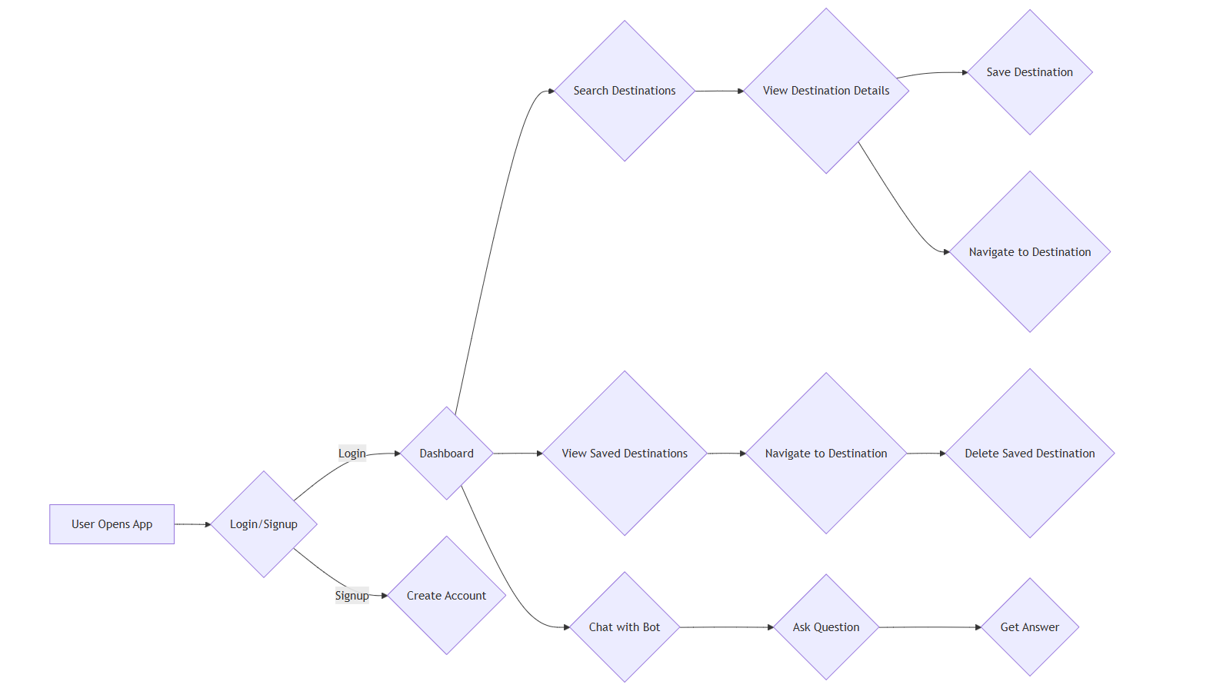
Methodology

Slide 9
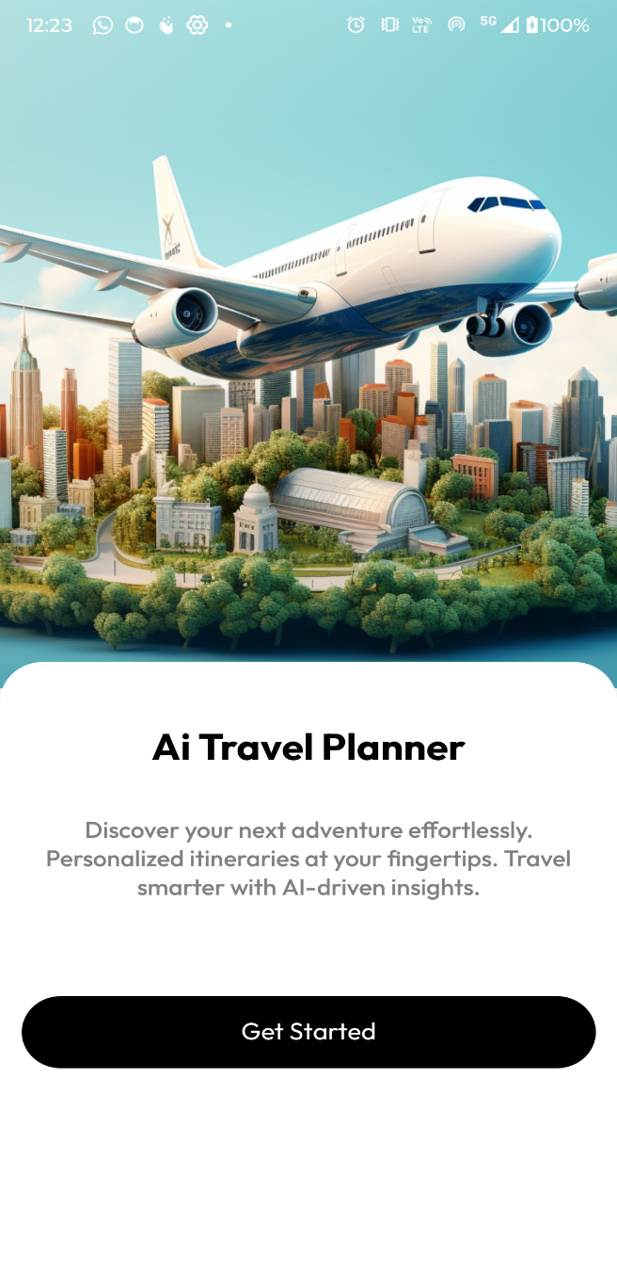
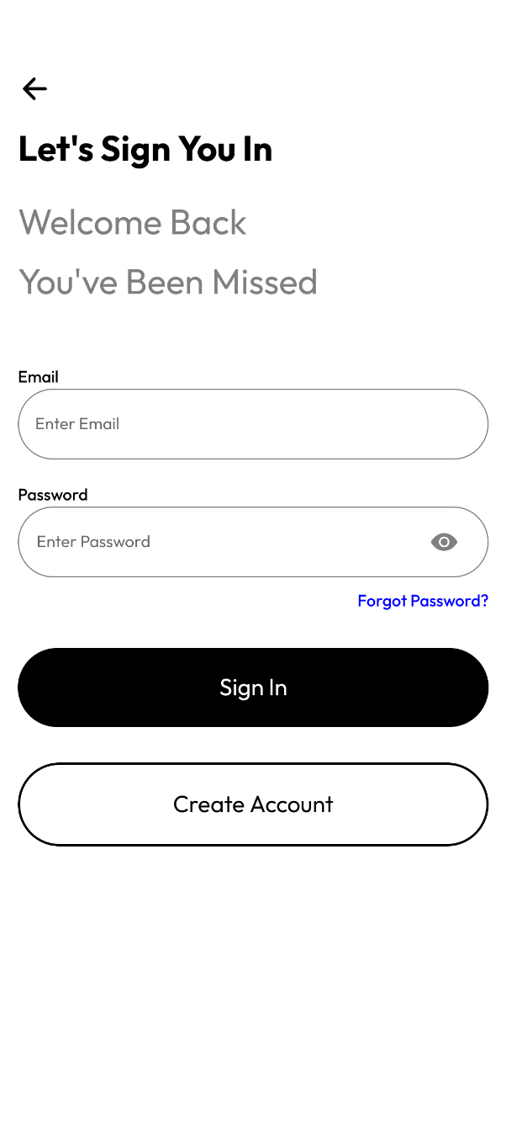
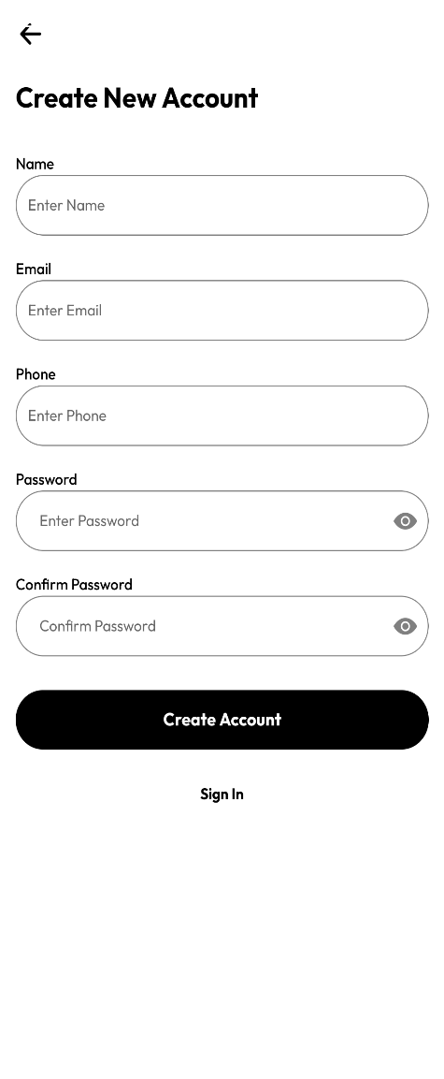
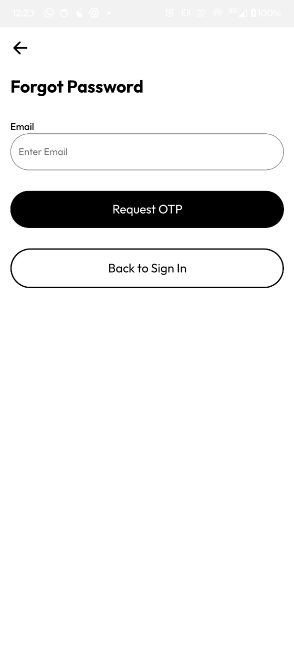
Expected Outcome

Slide 10
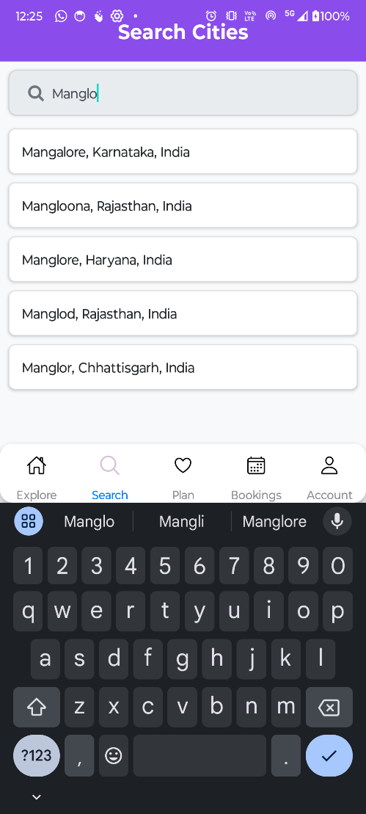
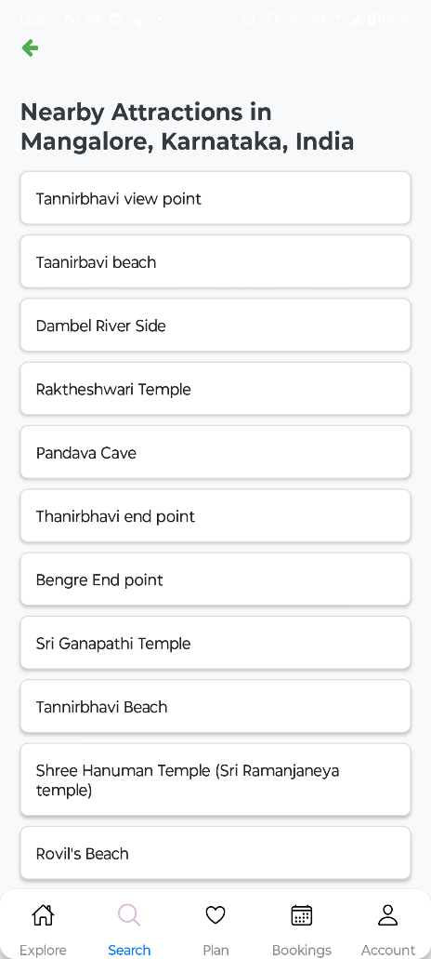
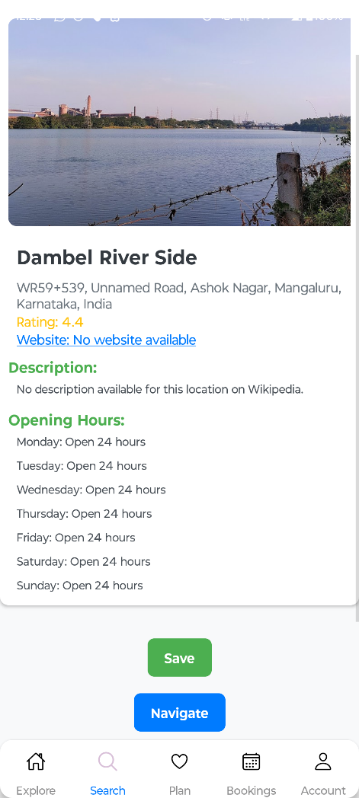
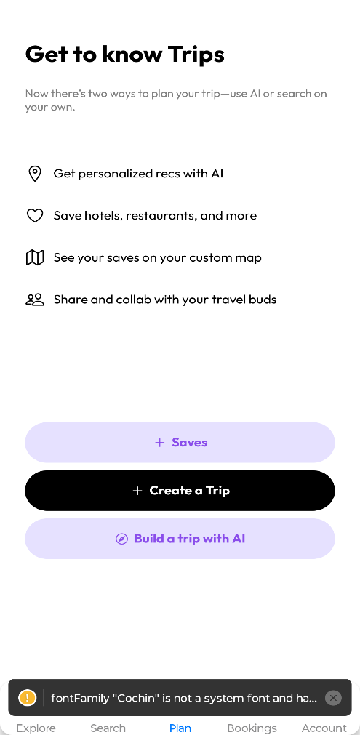
Expected Outcome

Slide 11
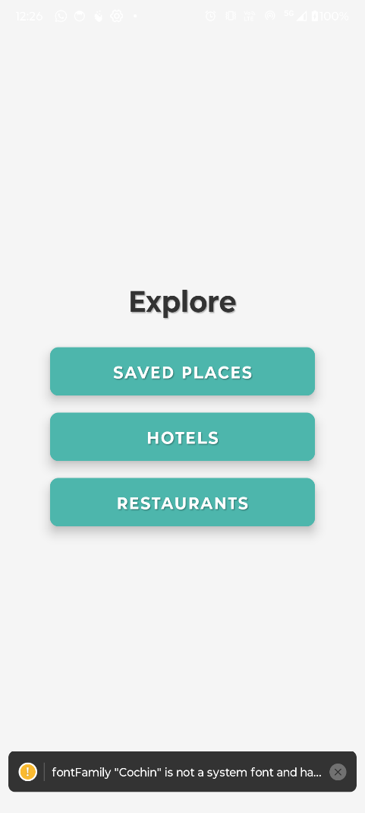
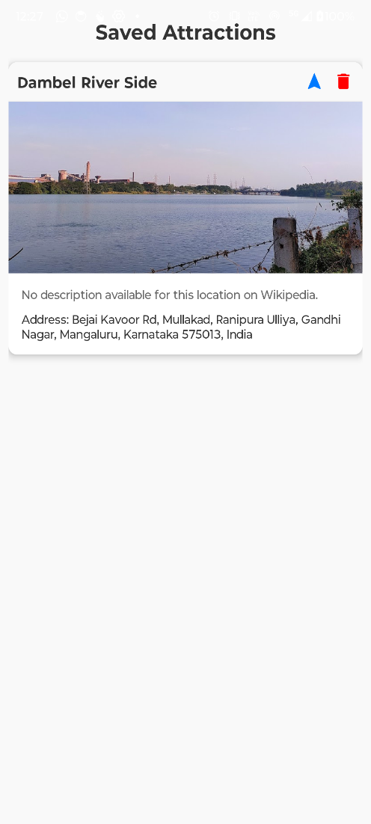
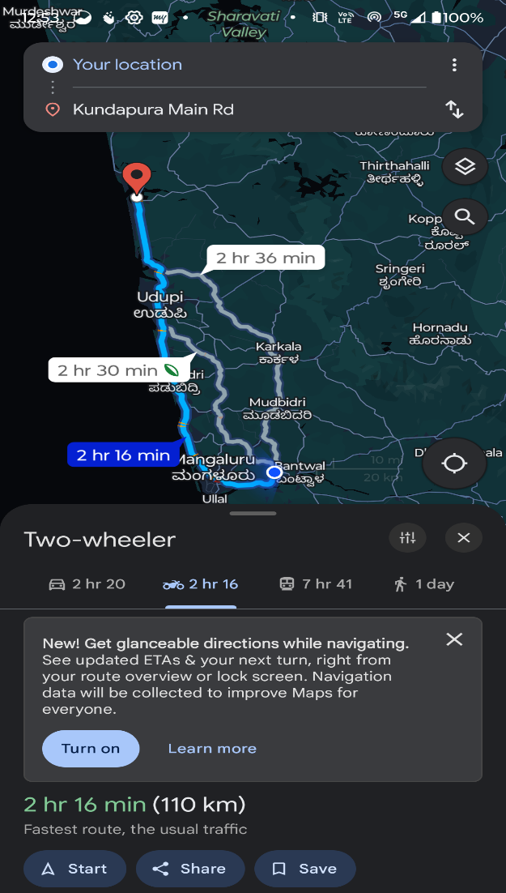
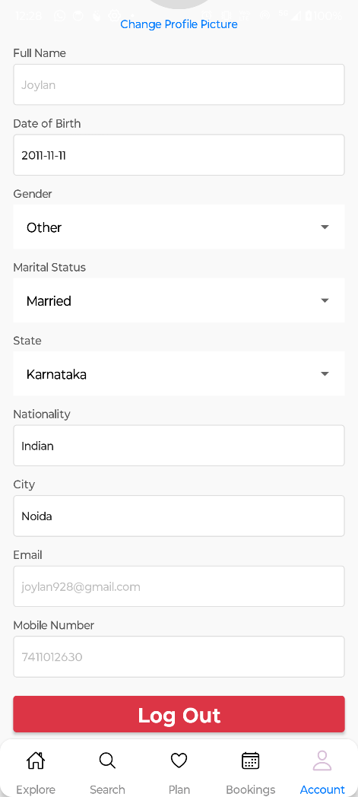
Expected Outcome

Slide 12
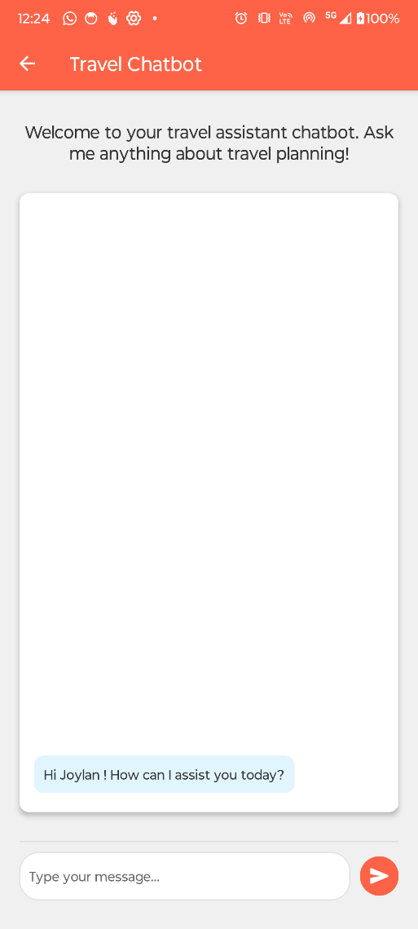
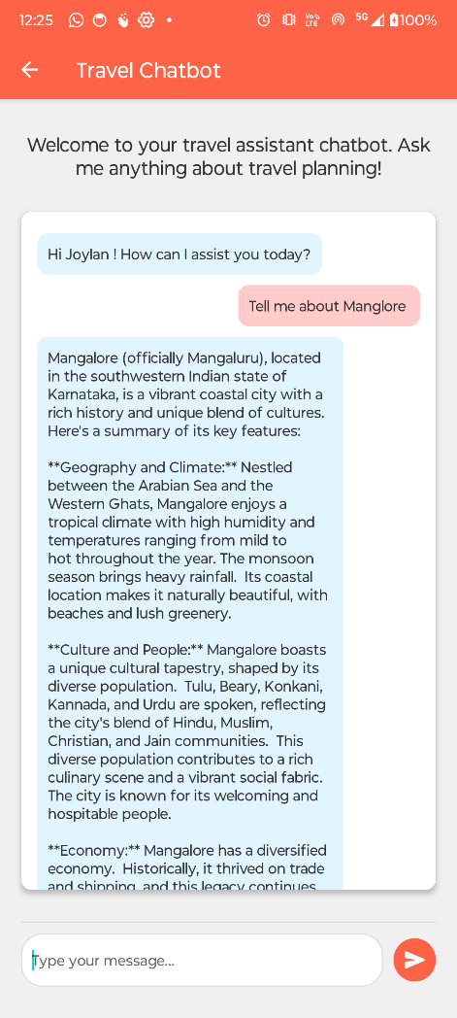
Expected Outcome

Slide 13
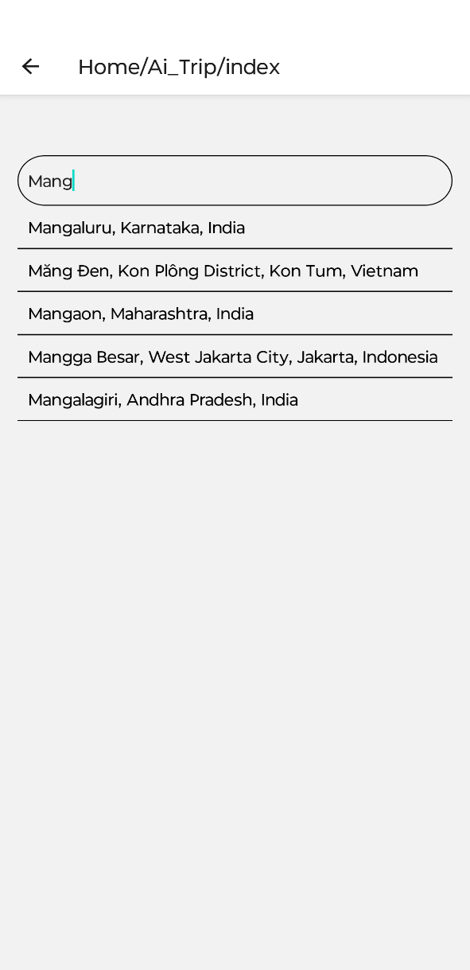
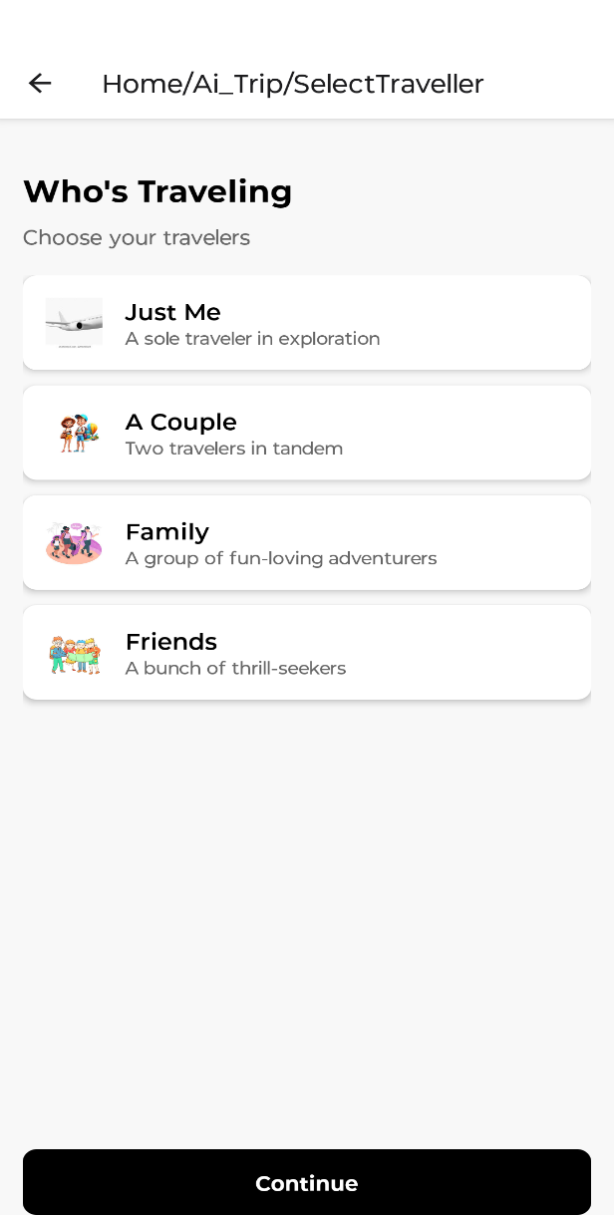
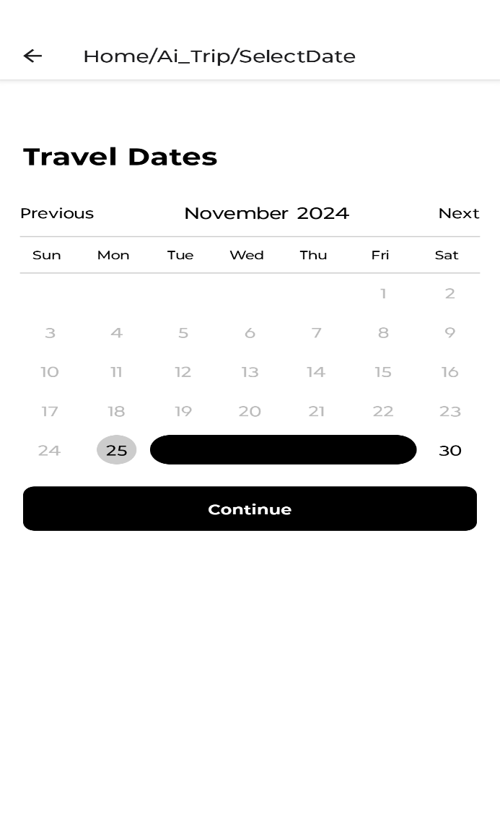
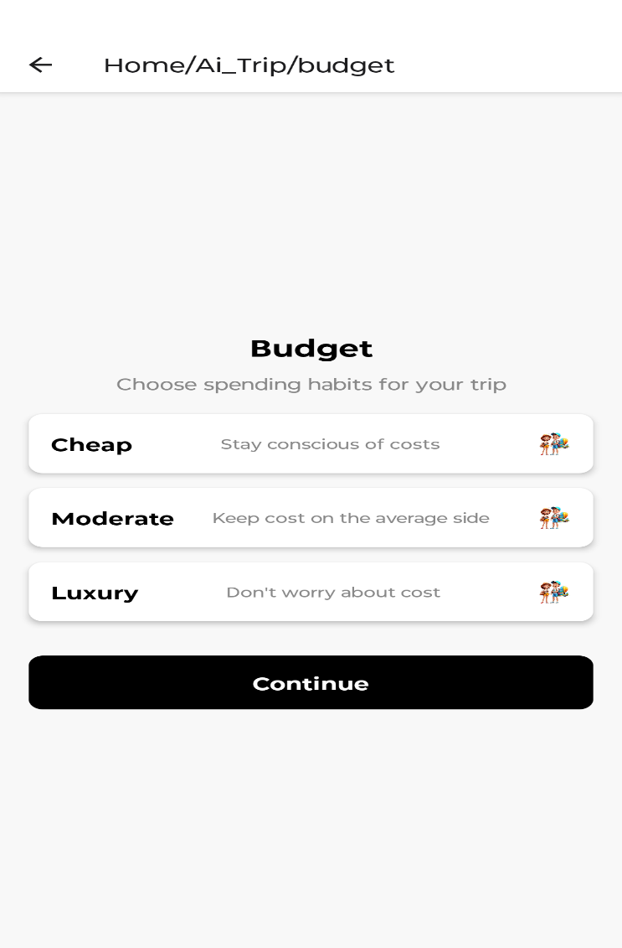
Expected Outcome

Slide 14
Conclusion
The Comprehensive Travel Planner App effectively addresses the challenges travelers face in planning trips by providing an integrated platform for personalized recommendations and planning. The app simplifies the process by combining multiple functionalities, such as identifying attraction discovery, and navigation to the destination, into a single user-friendly interface. The integration of a chatbot powered by real-time data further enhances the user experience by offering tailored itineraries and recommendations based on user preferences. This innovative solution streamlines travel planning, promoting convenience and satisfaction for users.

Slide 15
THANK YOU

